Slide 1
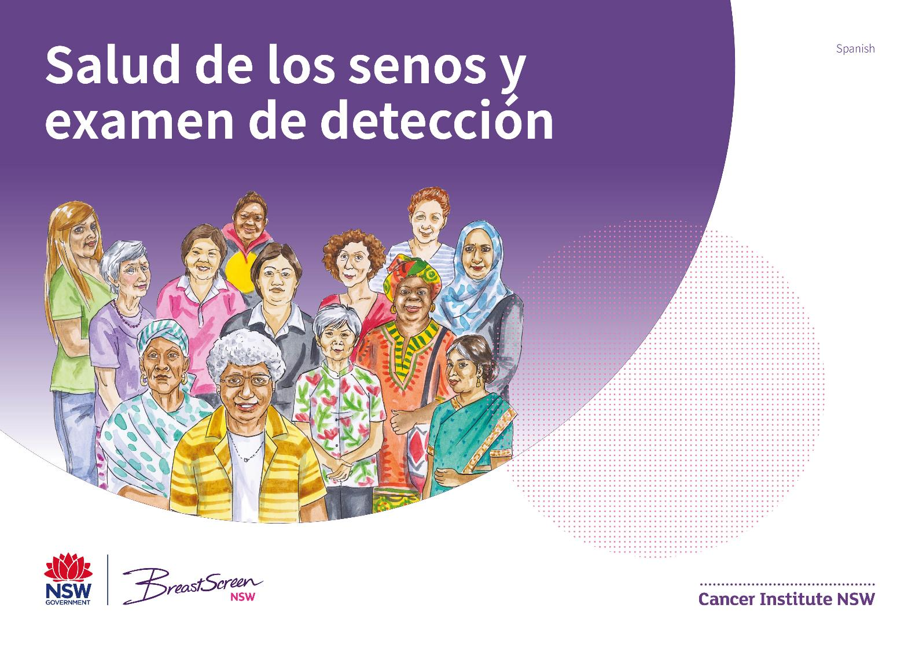
Notes:
Breast health and breast screening

Slide 2


Slide 3
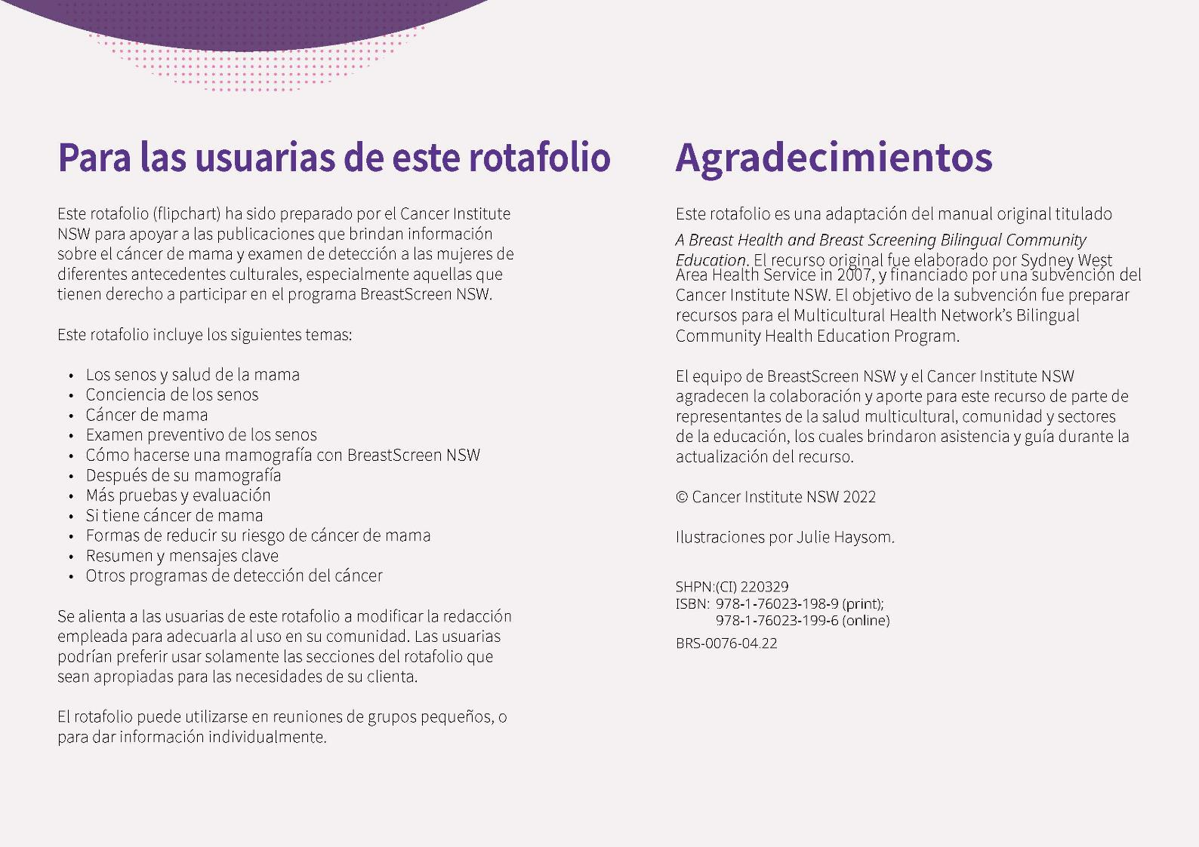
Notes:
For users of this flipchart
This flipchart has been produced by the Cancer Institute NSW to support those providing information on breast cancer and breast screening to women from different cultural backgrounds; particularly those eligible to participate in the BreastScreen
NSW program.
This flipchart includes the following topics:
• The breast and breast health
• Breast awareness
• Breast cancer
• Breast screening
• Having a mammogram with BreastScreen NSW
• After your mammogram
• More tests and assessment
• If you have breast cancer
• Ways to reduce your risk of breast cancer
• A summary and key messages
• Other cancer screening programs
Users of this flipchart are encouraged to modify the wording provided to suit their particular community. Users may prefer
to only use sections of the flipchart that are appropriate for their client’s needs.
The flipchart may be used in small group situations or for
one-on-one information sharing.
Acknowledgements
This flipchart has been adapted from the original manual titled
A Breast Health and Breast Screening Bilingual Community Education manual. The original resource was developed by Sydney West Area Health Service in 2007, and funded by a Cancer Institute NSW grant. The purpose of the grant was to develop resources for the Multicultural Health Network’s Bilingual Community Health Education Program.
The BreastScreen NSW team at the Cancer Institute NSW gratefully acknowledges the contribution and input into this resource by representatives of the multicultural health, community and education sectors who provided assistance
and guidance during the updating of this resource.
© Cancer Institute NSW 2018
Illustrations by Julie Haysom.

Slide 4
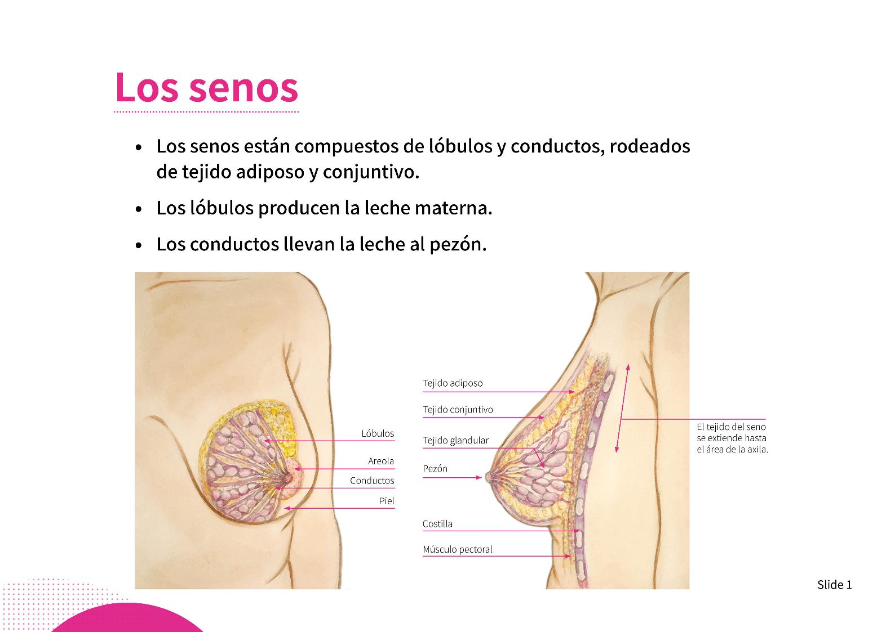
Notes:
The breast
• Breasts are made up of lobules and ducts surrounded by fatty and connective tissue.
• Lobules produce breast milk.
• Ducts carry milk to the nipple.
• Breast tissue covers not just the breast mounds, but also the area from the collarbone to the bra line, and may extend into the glands under the arms. Please see activity.
Activity
Demonstrate the area from your collarbone to bra line and point to the glands under your arms.

Slide 5
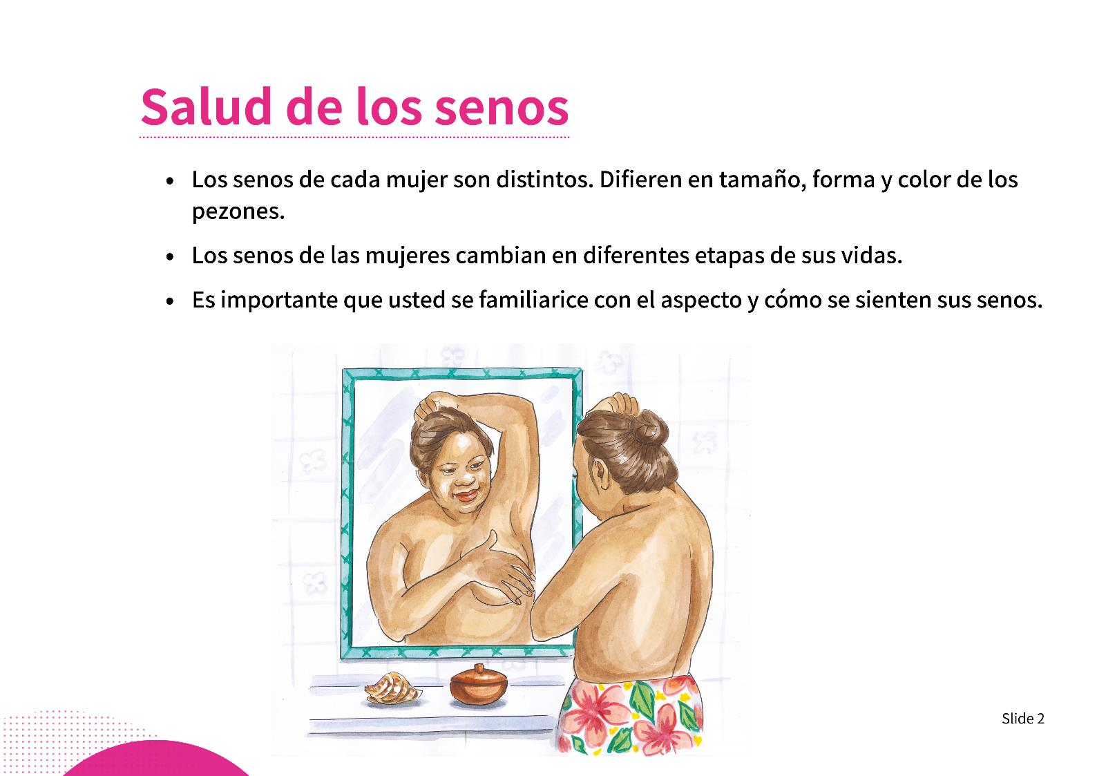
Notes:
Breast health
• Every woman’s breasts are different. Breasts differ in size, shape and colour of the nipples.
• Women’s breasts change at different times in their lives. They change with women’s menstrual cycle, when pregnant, while breastfeeding, and as we grow older.
• It’s sometimes hard for us to talk about our breasts to others because our breasts are private.

Slide 6
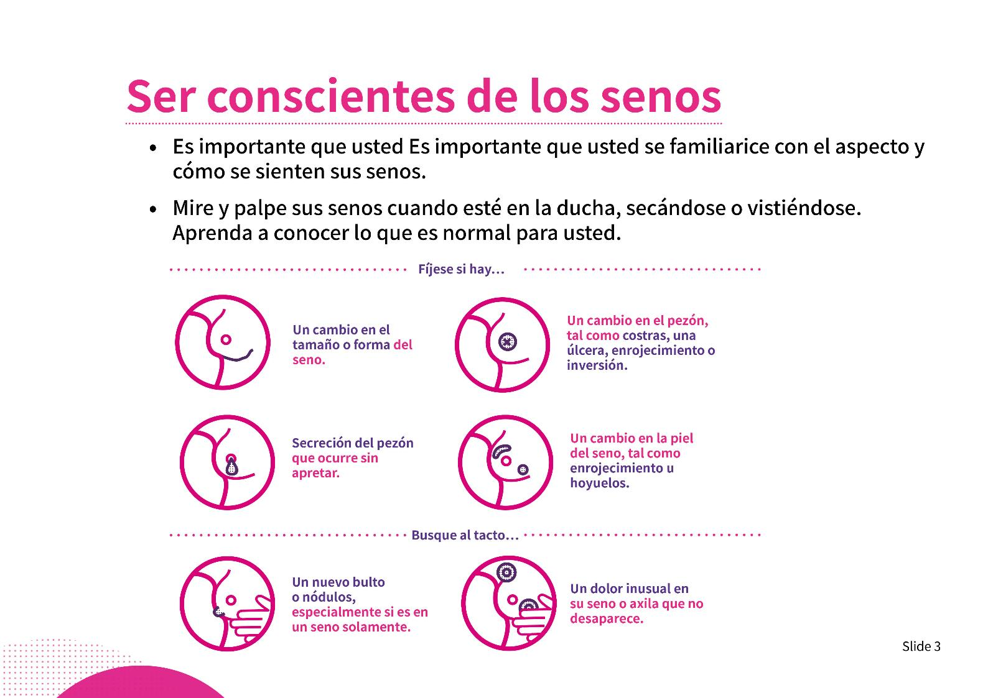
Notes:
Being breast aware
• Look at and feel your breasts when you are showering, drying yourself or dressing. Get to know what is normal for you.
• Do you know what your breasts usually look like?
• If you notice any changes, or feel a lump in your breast, see your doctor as soon as possible.
Breast changes to be aware of (refer to graphic):
• If you notice any of these changes, discuss this with your doctor as soon as possible.
• Remember, it’s never too early or too late to start being breast aware. It’s important to check your breasts.

Slide 7
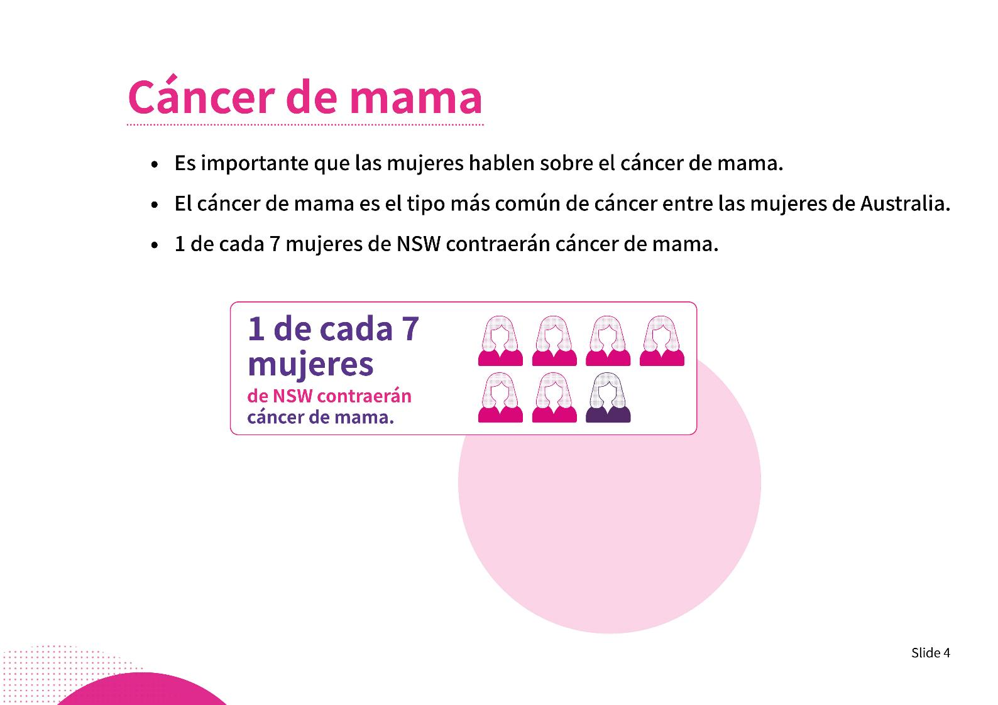
Notes:
Breast cancer
It’s important for women to talk about breast cancer:
• Many of us have uncomfortable feelings about cancer.
• Some of us find that just saying the word cancer is frightening, or we don’t want to say it out loud.
• There are many different reasons it can be difficult to talk about cancer (see activity).
Breast cancer:
• Breast cancer is the most common cancer among women.
• As you can see, 1 in 7 women in NSW will develop breast cancer.
• Men also develop breast cancer. However, this is far less common.
Myths and misconceptions:
• You cannot catch breast cancer. It’s not contagious.
• Breast cancer is a common health issue for women; it’s not something to feel ashamed of.
• Injuries to your breast do not cause breast cancer.
• You cannot get breast cancer just by talking about it.
Activity
How does talking about cancer make you feel?
Do you know someone who has experienced breast cancer?

Slide 8
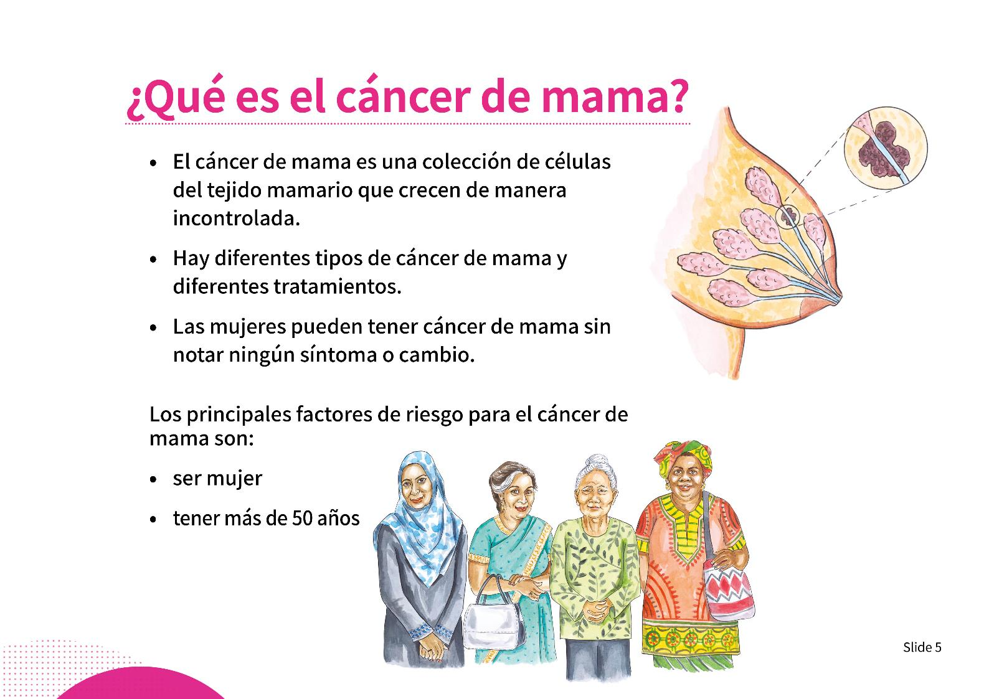
Notes:
What is breast cancer?
• Breast cancer is a collection of cells in the breast tissue that grow in an uncontrolled manner.
• There are different types of breast cancer. This can depend on where the cancer is within the breast, or if it has spread to an area outside of the breast.
• Being a female and over 50 are the two biggest risk factors for breast cancer.
• Having regular screening mammograms is the best way to find breast cancer early in women over 50.
• Even if there is no breast cancer in your family, you are still at risk.
• If you do have a family history of any type of cancer, please talk to your doctor about this.
Finding breast cancer:
• Fear of finding cancer can be a reason why some women do not have mammograms.
• A mammogram cannot stop you from getting breast cancer, but is the most effective way to find breast cancer.
• Mammograms can find cancers when they are as small as a grain of rice.
• Even when they are diagnosed with breast cancer, women may not identify as being “sick” or “unwell”.
• When breast cancer is found early, women have more treatment options and better outcomes.

Slide 9
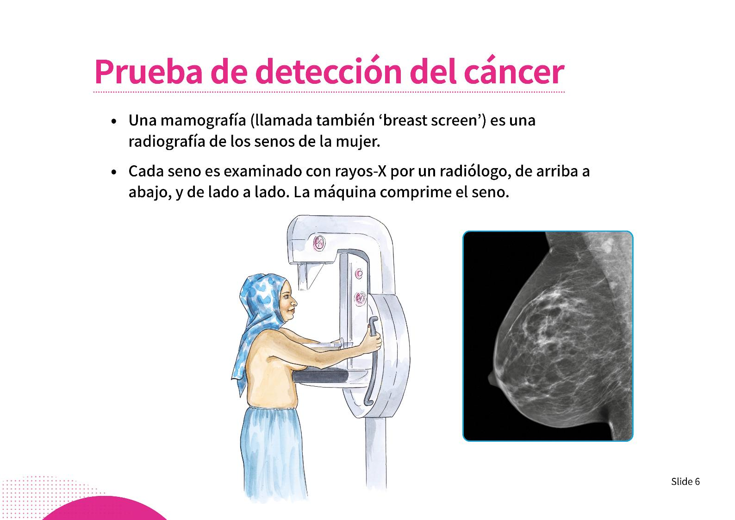
Notes:
Breast screening
• A mammogram is an x-ray of a woman’s breast.
• The mammogram is done by a female radiographer.
• Each breast is x-rayed from top to bottom, and from side to side.
• The mammogram presses the breast (demonstrate with hands) to get the best picture of the breast possible.
• The pressing can be uncomfortable, but should not be painful. The breast is only pressed for a few seconds – it is very quick.
Other information:
• Radiation: As with any x-ray, a very low amount of radiation is needed when taking a mammogram. Research shows that the benefits of having a mammogram outweigh any risks from radiation.
• Breast implants: Most women with breast implants can have a mammogram. Women need to tell BreastScreen NSW when they make their appointment.
• Pregnancy: Women who are pregnant are not eligible to be screened.
• Breastfeeding: Women who are breastfeeding should advise the staff when making their appointment.

Slide 10
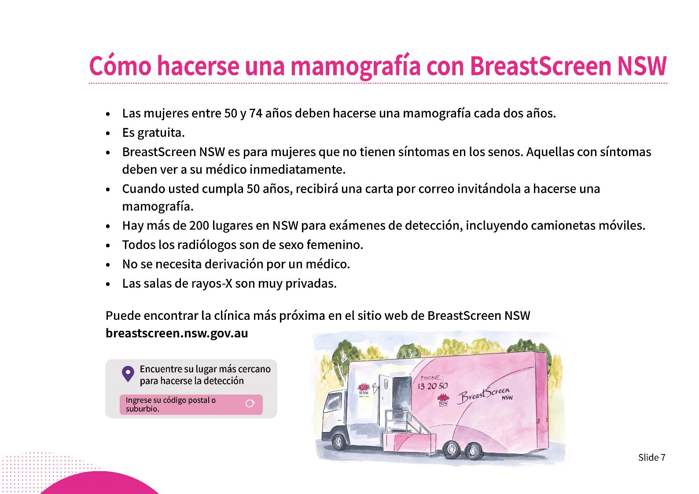
Notes:
Having a mammogram with BreastScreen NSW
• BreastScreen NSW recommends women aged 50–74 years have a mammogram every two years. Research tells us screening is of most benefit for women in this age group.
• Reminder letters are sent every two years for women in this age group.
• BreastScreen has many screening clinics across NSW, as well as mobile vans that visit more than 180 locations every two years.
• Radiographers are female and specially trained.
• The x-ray rooms are very private, with just the client and the radiographer present.
• A doctor’s referral is not required.
• Call 13 20 50 to book an appointment. Call 13 14 50 if an interpreter is required.
Women 40–49 years and women 75 and over
• The risk of breast cancer is lower in these age groups.
• Talk to your doctor about whether screening at this time is right for you.
Women who have screened previously with BreastScreen
• Women who have screened previously can book online using a special code. BreastScreen will send the code to you in a letter.
• If you do not receive a letter from BreastScreen, you should call and make an appointment.
Activities
• Hand out BreastScreen NSW appointment cards and brochures to all women.
• Mock call to make a booking.
• Demonstrate searching for a clinic by suburb online (www.breastscreen.nsw.gov.au).
• Consent forms: Explain and assist women to complete their consent form, which they will need to provide at their appointment.

Slide 11
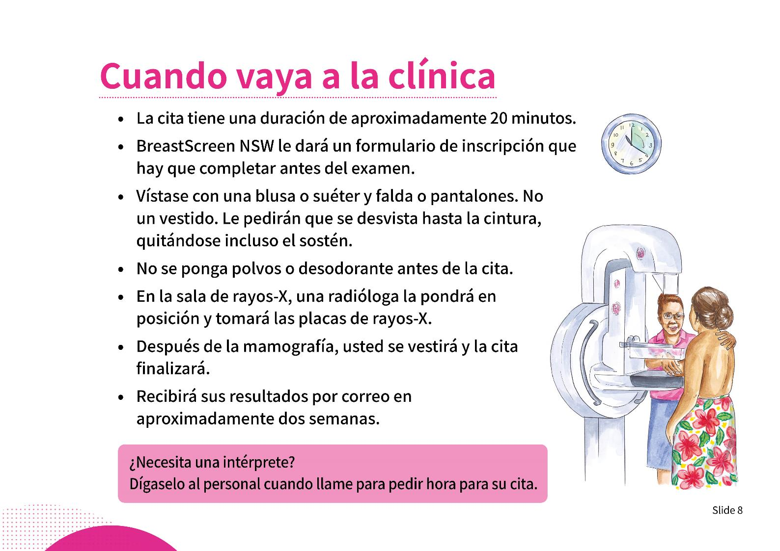
Notes:
Going to the clinic
Interpreters
• Do you need an interpreter? Please tell staff when you book your appointment that you need an interpreter.
• In most cases it will be a telephone interpreter, arranged by the BreastScreen NSW reception staff.
• Please do not bring family members as interpreters, especially children.
What happens at the clinic?
• Your appointment will take about 20 minutes.
• BreastScreen NSW will give you a registration form that will need to be completed before you are screened. Please ask the staff any questions you may have.
• Wear something that is easy to take off for your appointment, such as a top with a skirt or pants. You will be asked to undress to the waist, including removing your bra.
• Do not use powder or deodorant before your appointment.
• In the x-ray room, a female radiographer will position you and take the x-rays. This will include touching your breast.
• The x-ray plates need to press very firmly on your breasts to get the best picture possible. The pressure can be uncomfortable. However, it only lasts for a few seconds.
• After the mammogram, you will be asked to get dressed and the appointment will be finished.
• You will not be given your x-rays or results at this time.

Slide 12
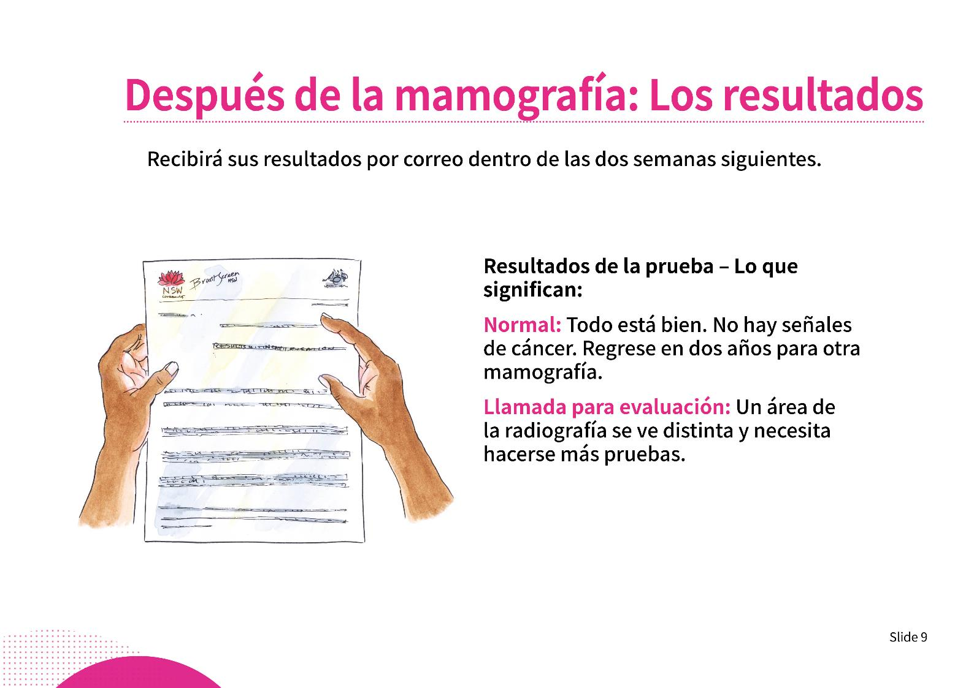
Notes:
After your mammogram: The results
• Two specially trained doctors will carefully examine your x-rays.
• You will receive your results in the mail within two weeks:
- Normal results: There is no evidence of breast cancer. You will be reminded to come back for another screening mammogram in two years.
- Recall to assessment: Sometimes something shows up on the x-ray that looks different to a normal breast x-ray and you will be called back for more tests. It is very important to go back and have the extra tests.
- 1 in 10 women will be called back for more tests.

Slide 13
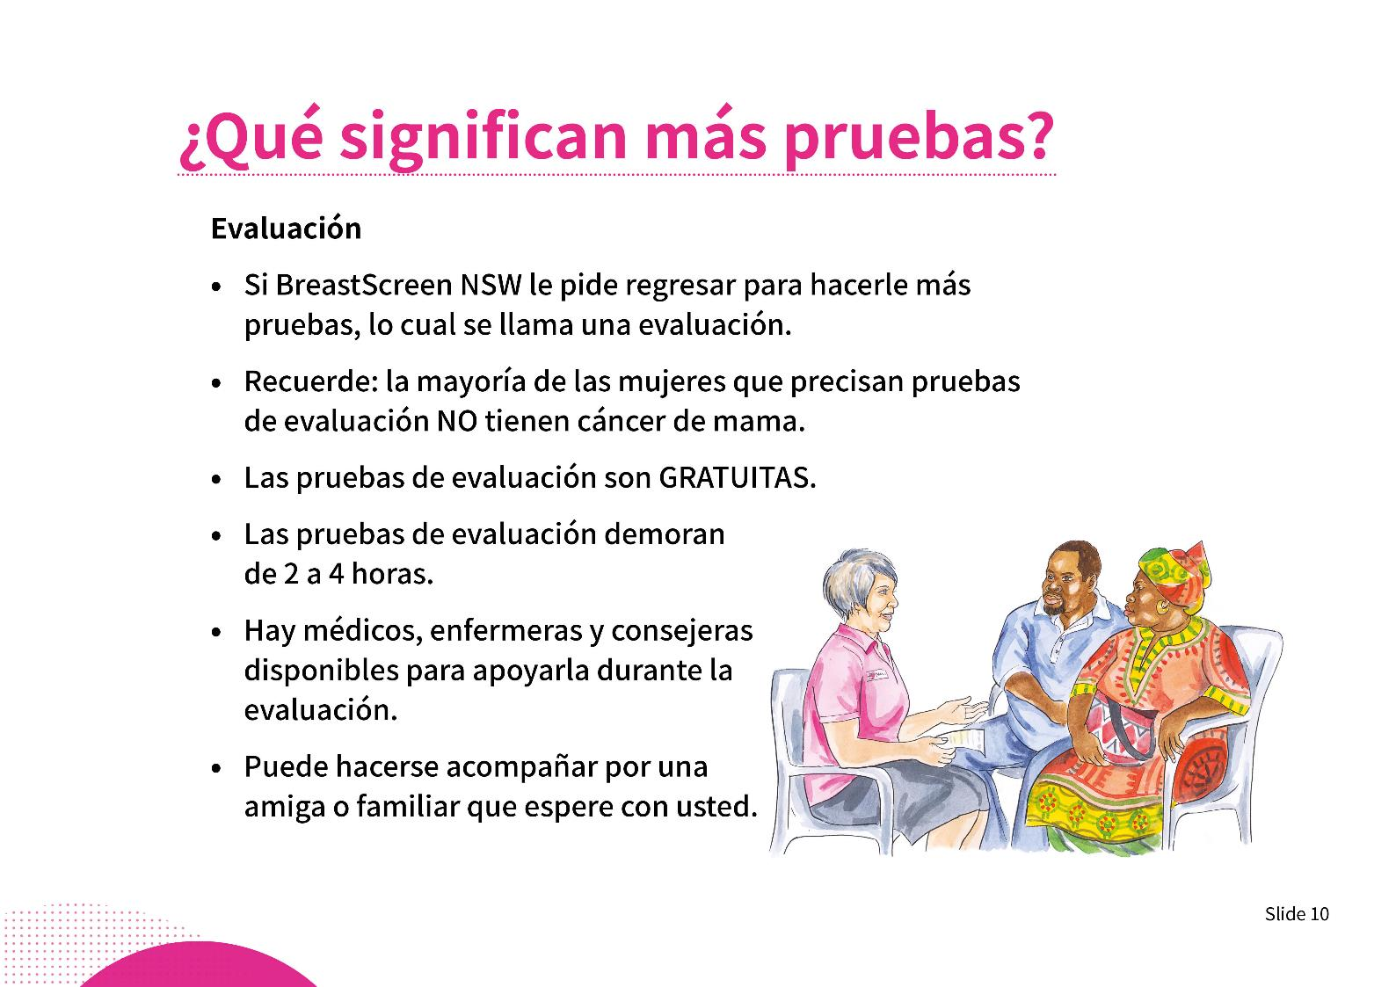
Notes:
What are more tests?
Assessment
• If BreastScreen NSW asks you to return for more tests, this is called an assessment.
• Remember, most women who have assessment tests do NOT have breast cancer.
• Assessment tests are FREE.
• Assessment tests take 2–4 hours.
• You can bring a friend or relative to wait with you.
• Doctors, nurses and counsellors are available to support you during the assessment.

Slide 14
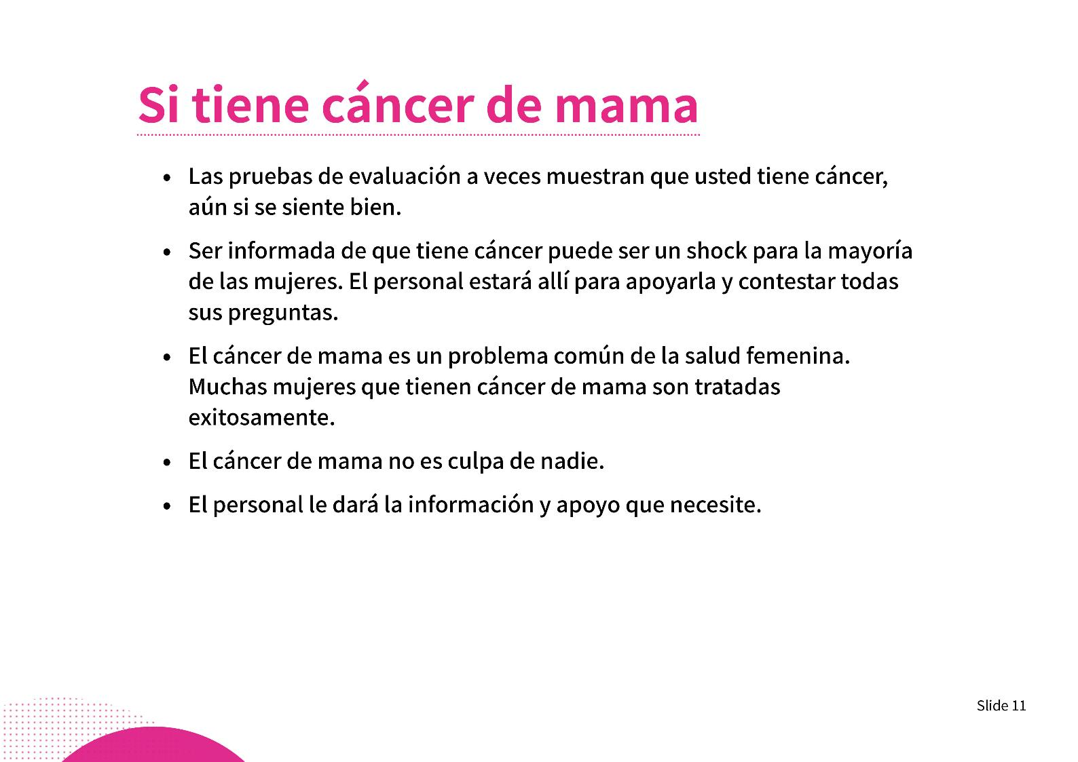
Notes:
If you have breast cancer
• Assessment tests sometimes show that you have breast cancer, even if you are feeling well or have no obvious signs or symptoms.
• Being told you have breast cancer can come as a shock to most women. Highly trained staff will be there to support you and answer all your questions.
• Breast cancer is a common women’s health issue. Most women who have breast cancer are treated successfully.
• It is not your fault. It is not something to be ashamed of. You can’t make it worse by talking about it.
• You will receive information about the type of breast cancer, your treatment options and what to do next.

Slide 15
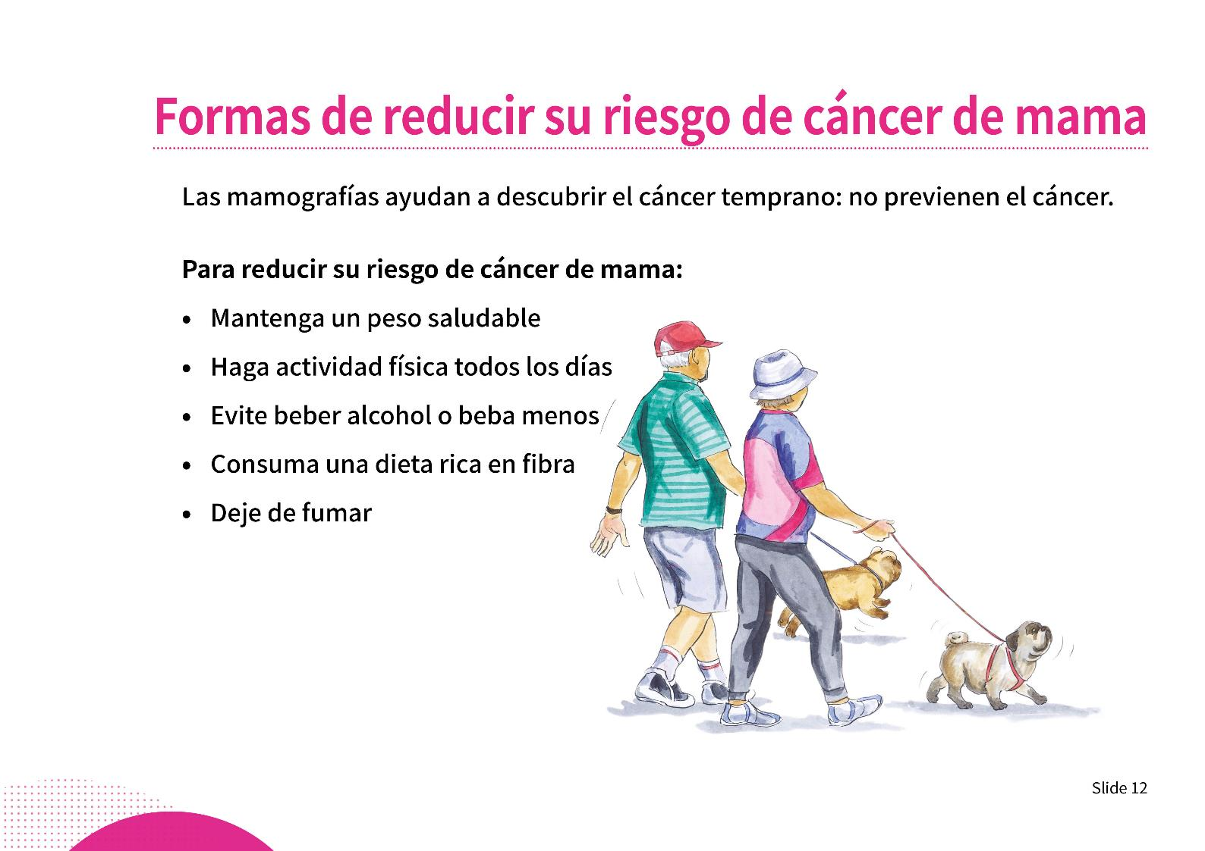
Notes:
Ways to reduce your risk of breast cancer
Mammograms help find breast cancer early; they do not prevent cancer.
To reduce your breast cancer risk:
• Maintain a healthy body weight. Find out if you are a healthy weight by talking to your doctor.
• Be physically active every day.
• Avoid alcohol or reduce the amount you drink.
• Eat a healthy diet that is high in vegetables, fruit, legumes, and wholegrains, such as wholemeal pasta, noodles, bread, brown rice, oats and couscous. Aim for two serves of fruit and five serves of vegetables each day.
• Eat less red meat and avoid processed meats such as bacon, ham and salami.
• Quit smoking.

Slide 16
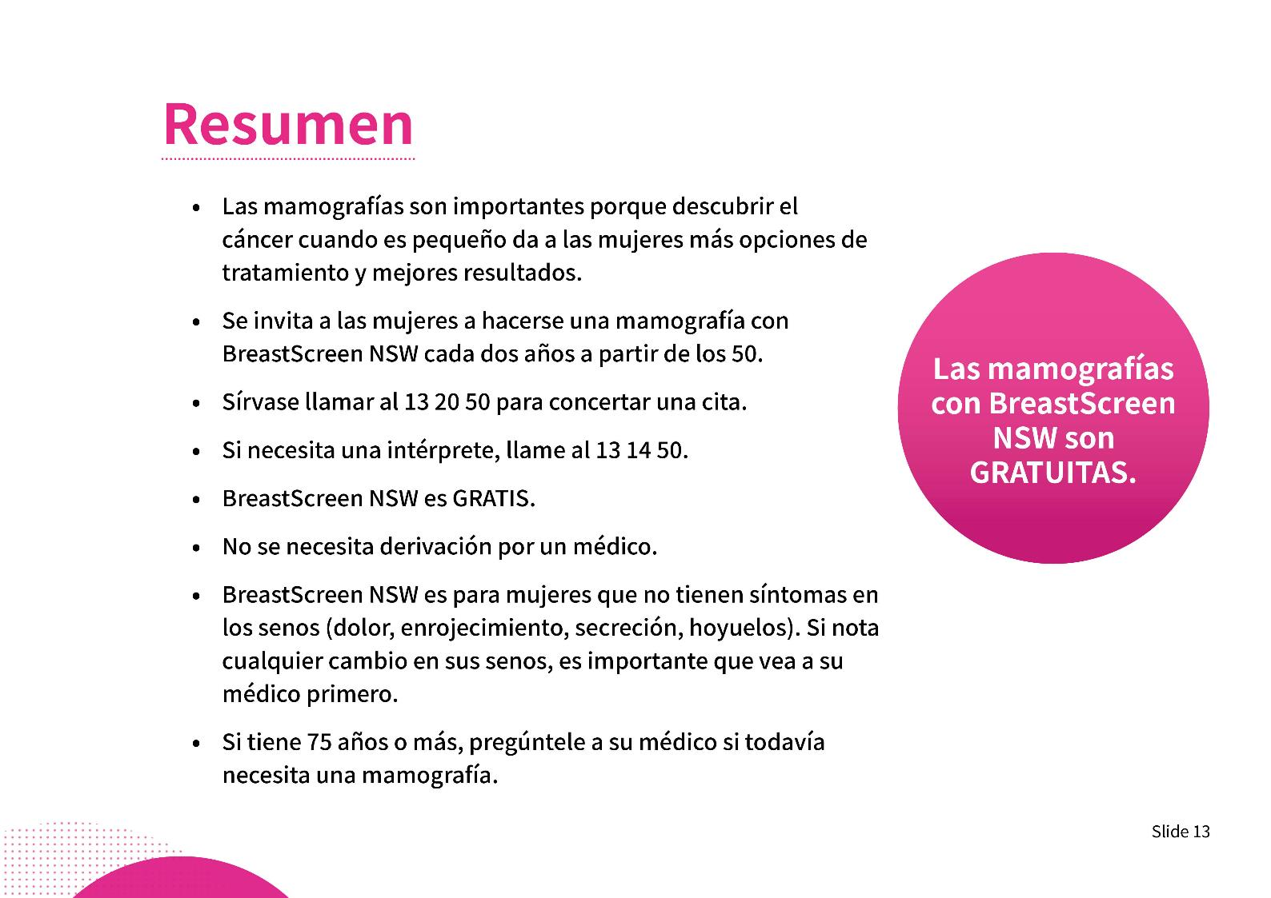
Notes:
Summary
• Mammograms are important.
• Finding breast cancer when it is small gives women the best chance of successful treatment and being well again.
• Women are invited (usually by a letter in the mail) to have a mammogram with BreastScreen NSW every two years from the age of 50.
• If you do not receive an invitation, please call and make an appointment.
• Mammograms with BreastScreen NSW are FREE and a doctor’s referral is not needed.
• Call 13 20 50 to book an appointment. If you need an interpreter, call 13 14 50.
• Most women who develop breast cancer DO NOT have a family history of breast cancer.
• BreastScreen NSW is for women with no breast symptoms (soreness, redness, discharge, dimpling). If you notice any changes in your breasts, it is important to see your doctor first.
• From age 75, BreastScreen NSW stops sending reminder letters. However, you can keep coming for free. Talk to your doctor about whether you need to keep having mammograms.

Slide 17
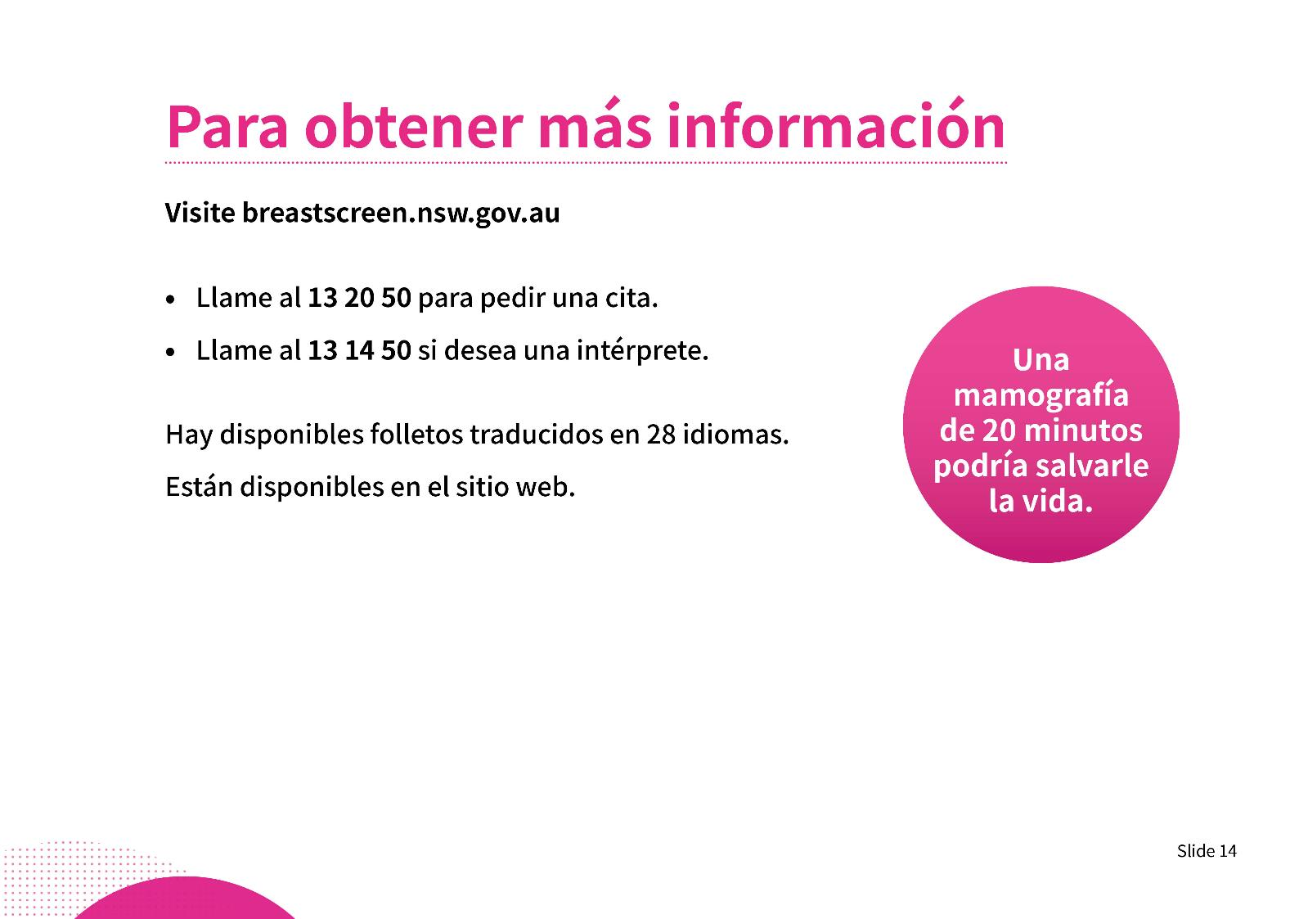
Notes:
For more information
• Visit the program website at: breastscreen.nsw.gov.au.
• Call BreastScreen NSW on 13 20 50.
• If you need help in your language, call the Translating and Interpreting Service on 13 14 50.
Demonstrate finding the brochures from the website
Translated brochures are available in 28 languages
www.breastscreen.nsw.gov.au/about-screening-mammograms/information-in-other-languages.

Slide 18
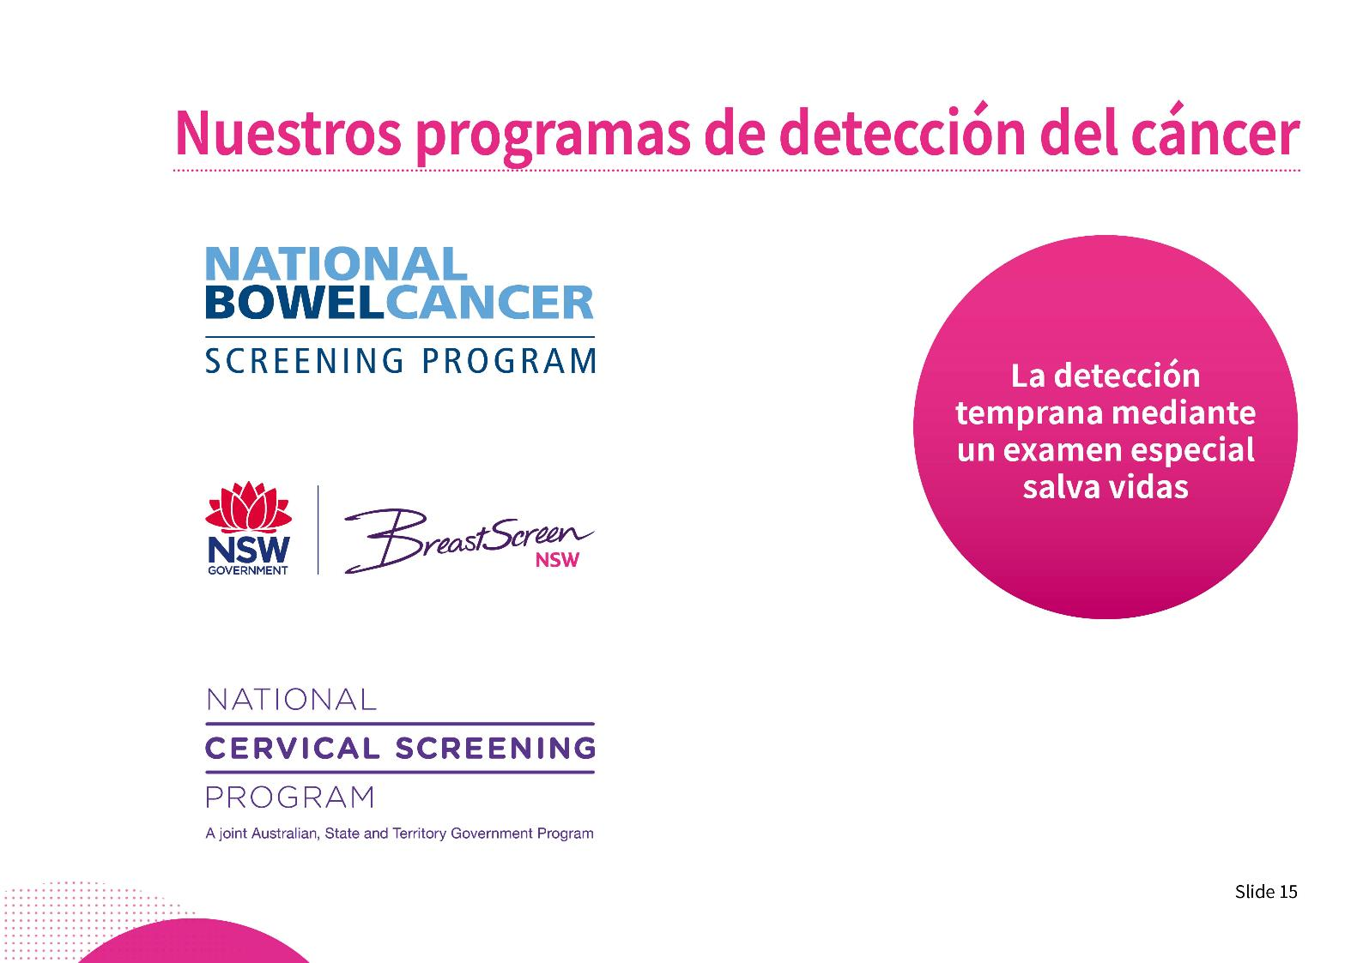
Notes:
Our cancer screening programs
Screening programs in Australia
• Cancer screening is the use of simple tests to look for early signs of cancer, or the conditions that cause cancer.
• Screening tests can find cancer before you can see or feel any changes to your body. When you find cancer early, it is easier to treat successfully.
• In Australia, there are three national screening programs. These are for bowel, breast and cervical cancers.
• If you are unsure about doing a screening test, talk to your doctor to help you decide.

Slide 19
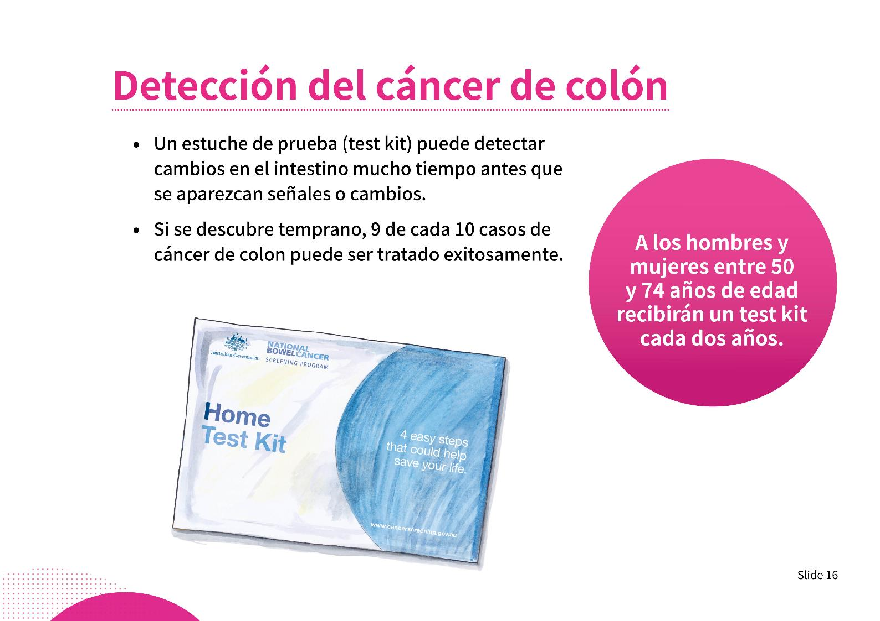
Notes:
Bowel Screening
If you’re aged 50–74 years and have a Medicare card, the Commonwealth Government will send you a free bowel screening test kit in the mail every 2 years.
• Bowel cancer can develop slowly, without any signs or symptoms.
• The bowel screening test kit is free, simple and can be done in your own home.
• The test can find changes in the bowel early.
• If found early, 9 out of 10 bowel cancers can be successfully treated.
• Do the test when it comes in the post. It could save your life.
• The test kit instructions and other resources are available online in more than 20 languages: cancerscreening.gov.au/translations.
• To find out more, call the National Bowel Cancer Screening Program info line on 1800 627 701 or call the Translating and Interpreting Service on 13 14 50 (for help in your language).

Slide 20
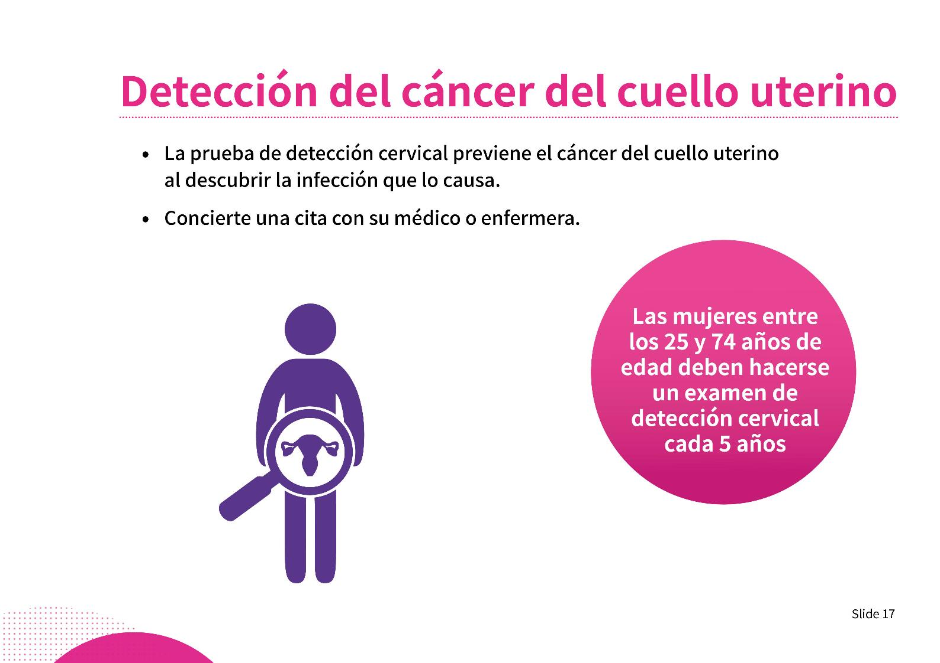
Notes:
Cervical screening
• Women aged 25–74 should have cervical screening every 5 years.
• You can book a Cervical Screening Test with your local doctor or nurse. You don’t need to go to a specialist doctor.
• Some doctors provide this for free. You can ask about the cost when you book an appointment.
• You can ask for a female doctor or nurse to perform the test.
• Cervical cancer can be prevented by having the Cervical Screening Test, because it looks for an infection which causes cervical cancer.
• Book an appointment with your doctor or nurse.
Note: If it’s been more than 2 years since your last Pap test or you have never had a test before, you should book an appointment as soon as possible. If the result is normal you will then be due for your next test in 5 years’ time.

Slide 21
